Slide 1
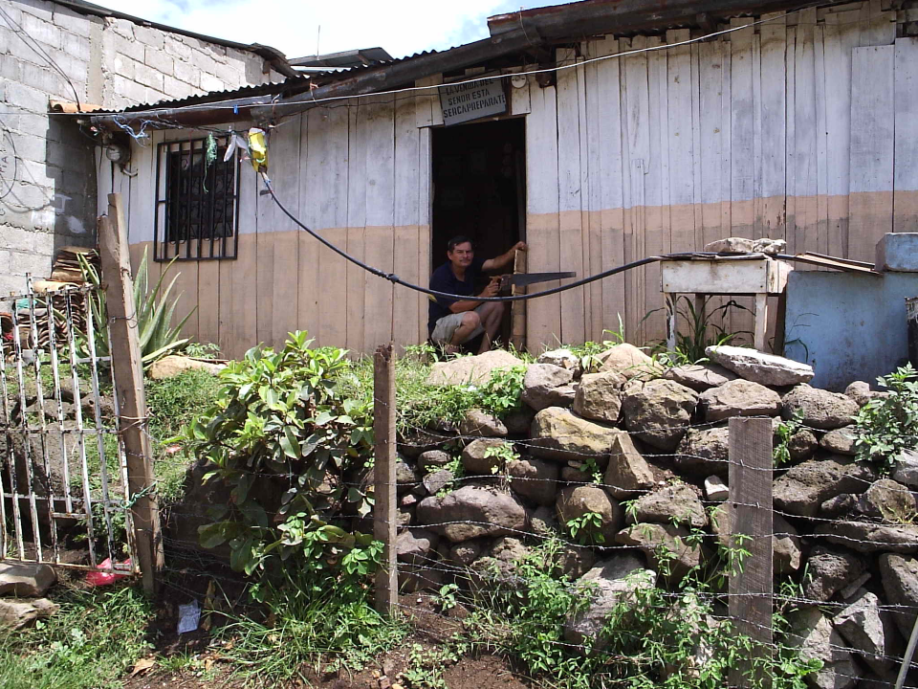
The State of the Planet
Sustainable Development Goals

Slide 2
Design Challenge
How is Onshape coming along?
Post issues at https://github.com/AguaClara/SWOT/issues
Are you playing?

Slide 3
How do we make the most out of this learning opportunity?
How can we build a community (face-to-face and online) of learning?
Invitation to use AguaClara Gather as an open meeting spot
Be skeptical and respectful and curious!

Slide 4
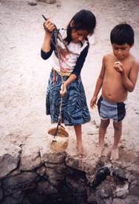
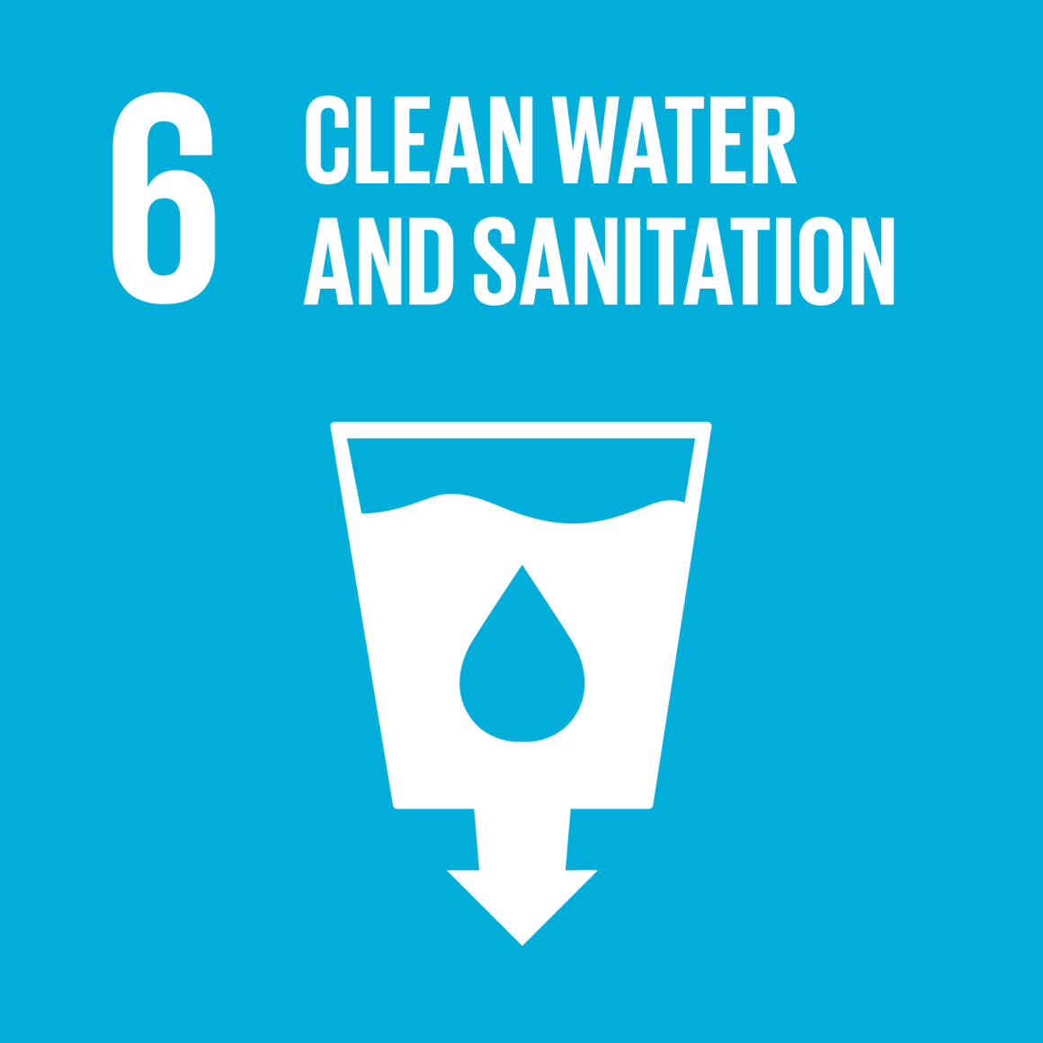
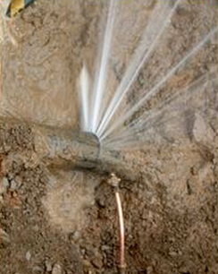
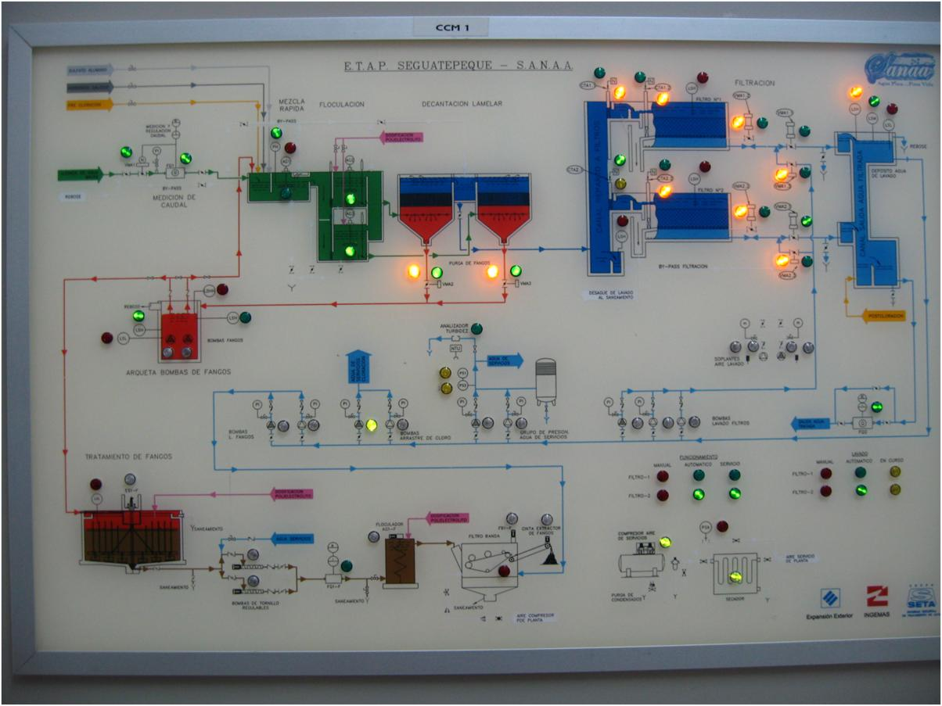
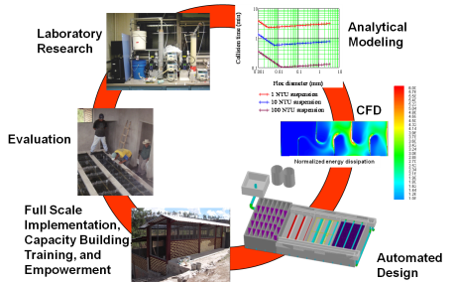
Overview
Burden of unsafe water
The Sustainable Development Goals
Safe and Improved…
Intermittent Supplies
The technology is well developed…
Cell phones vs. municipal water technology
A role for universities
Ctrl + click the pictures to go each section!

Slide 5
Overview
Burden of unsafe water
The Sustainable Development Goals
Safe and Improved…
Intermittent Supplies
The technology is well developed…
Cell phones vs. municipal water technology
A role for universities
Ctrl + click the pictures to go each section!

Slide 6
WHO Fact sheet on water (2017): The good news
(World Health Organization)
“In 2015, 71% of the global population (5.2 billion people) used a safely managed drinking-water service – located on premises, available when needed, and free from contamination.”
But let’s bring skepticism to this statement
This conclusion was made without collecting data on water quality in rural areas
This underestimates the billions who have unsafe water on tap!
Notes:
http://www.who.int/mediacentre/factsheets/fs391/en/
https://www.ircwash.org/blog/third-glass-three-quarters-full?utm_source=Amplify&utm_campaign=5c4000cc1e-Amplify_Aug_2017&utm_medium=email&utm_term=0_d60e6862b4-5c4000cc1e-48437621
Honduran government doesn’t even know how to contact the vast majority of the community water providers!

Slide 7
UN Fact sheet on water (2017) The bad news
90% of the global population (6.8 billion people) used at least a basic service. A basic service is an improved drinking-water source within a round trip of 30 minutes to collect water.
884 million people lack even a basic drinking-water service, including 159 million people who are dependent on surface water
Globally, at least 2 billion people use a drinking water source contaminated with feces
Contaminated water can transmit diseases such diarrhea, cholera, dysentery, typhoid, and polio
Contaminated drinking water is estimated to cause 500,000 diarrheal deaths each year
Notes:
http://www.who.int/mediacentre/factsheets/fs391/en/
Ridiculous number of significant digits. This is 1 billion and it might be 3 people…
This suggests that for a basic service it is okay if it contains feces.

Slide 8
Which problems are we solving?
Majority World problems?
The world lacking basic infrastructure (includes parts of the United States)
Minority World problems?
The world focused on self driving cars, smart cities, and Amazon Prime
A modest proposal: I will focus most of my creative energies on solving problems for the Majority World.

Slide 9
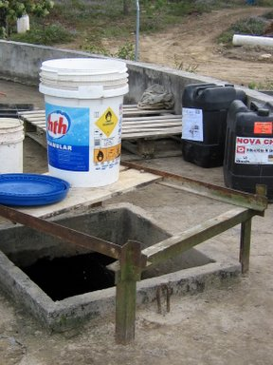
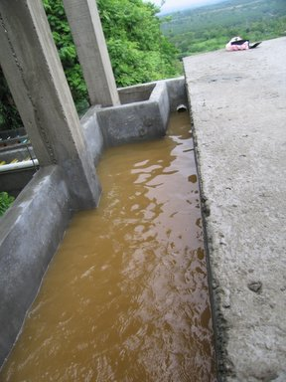
Honduras Stats as of 2015 (from WHO)
Population with sustainable access to an improved water source
Urban – 97.4%
Rural – 83.8%
Notes:
http://apps.who.int/gho/data/node.main.46?lang=en

Slide 10
Cost vs required personal effort: Current paradigm myth!
Where does the water come from for each of these treatment options?
Which costs more, distributing the water or treating the water?
Centralized water treatment
Vended water
Ceramic filters
Per-capita cost
Boiling
What are the assumptions underlying this infographic?
POU chlorination
Solar Disinfection
Personal (or household) effort required
Notes:
Adapted from presentation by Amy Pickering at Cornell University in December 2018.
Cost of centralized water treatment is the treatment part! This forgets that in a city you need centralized water provision in any case.
Vended water means tanker trucks instead of a distribution pipe network!!!!! Are we really saying tanker truck water is cheaper than piped water????
If you don’t have a water supply system that you don’t have any water to boil.
Boiling doesn’t make water that is aesthetically pleasing.
This forgot to ask what the consumer wanted!
Check the math!

Slide 11
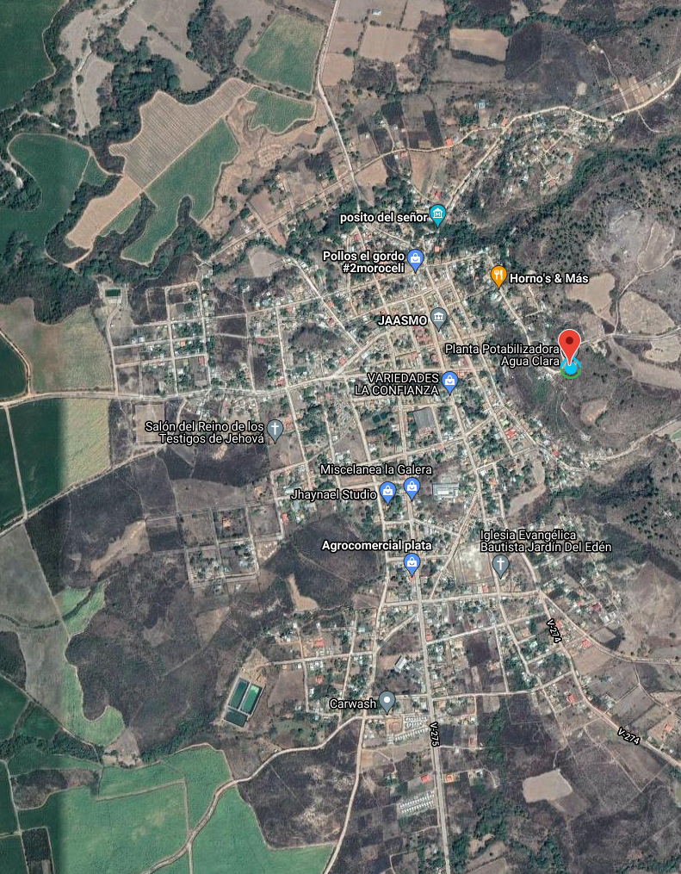
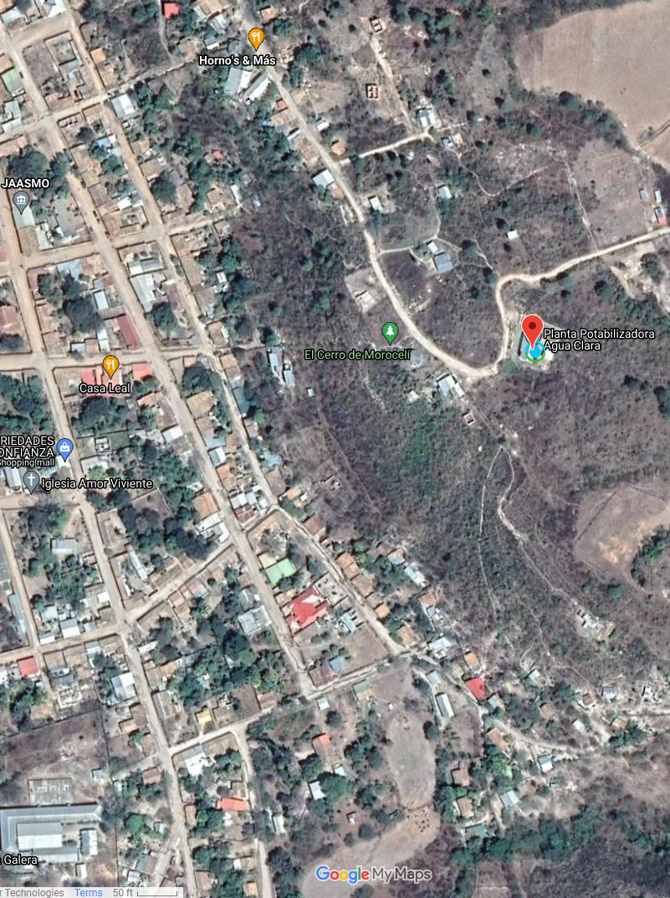
Moroceli, Honduras
Notes:
Distribution systems cost much more than the treatment plant to build

Slide 12
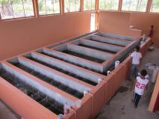
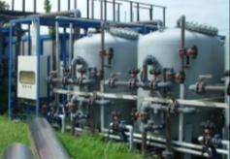
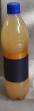
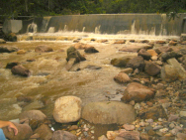
Value of Service and Willingness to Pay
Economics background: cost/quality framework
How do we understand the failure of some systems?
Where is the “sweet spot” for sustainability?
Untreated river water at the tap
Traditional Mechanized plant
AguaClara plant
2
3
Willingness to Pay ($/month)
Service method
Break-even line
Minimum quality for public health
1
Cost of service ($/month)
Notes:
The cases of 1 (small towns less than 25,000) and 2 (towns larger than 25,000) in Honduras are the norm.
Sustainability is above the x=y line
Incremental cost for treatment is small! (both capital cost and operating costs)

Slide 13
Overview
Burden of unsafe water
The Sustainable Development Goals
Safe and Improved…
Intermittent Supplies
The technology is well developed…
Cell phones vs. municipal water technology
A role for universities
Ctrl + click the pictures to go each section!

Slide 14
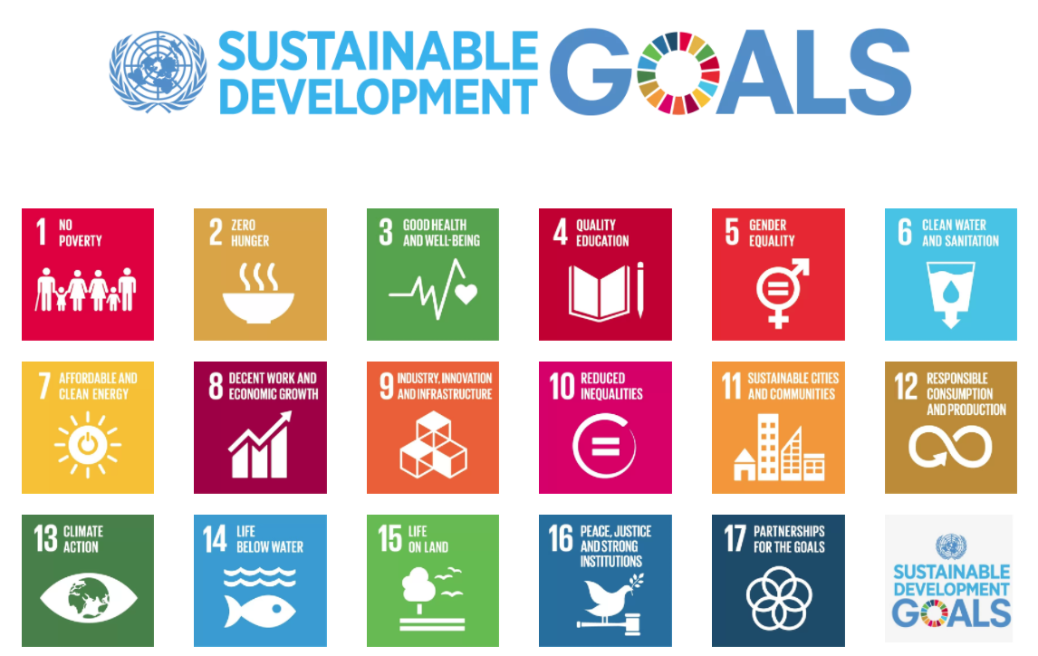
2015 to 2030
Notes:
On 1 January 2016, the 17 Sustainable Development Goals (SDGs) of the 2030 Agenda for Sustainable Development — adopted by world leaders in September 2015 at an historic UN Summit — officially came into force. Over the next fifteen years, with these new Goals that universally apply to all, countries will mobilize efforts to end all forms of poverty, fight inequalities and tackle climate change, while ensuring that no one is left behind.
http://www.un.org/sustainabledevelopment/development-agenda/

Slide 15

United Nations
“By 2030, achieve universal and equitable access to safe and affordable drinking water for all”
“Support and strengthen the participation of local communities in improving water and sanitation management” http://www.un.org/sustainabledevelopment/water-and-sanitation/

Slide 16

SDG 6.1: By 2030,safe and affordable drinking water for all
Some three in ten people (2.3 billion) lack access to safe and readily available water at home (or maybe it is 5 in 10…)
Additional 1.2 billion from population growth gives 3.5 billion need water by 2030
267 million people per year!
800,000 L/s per year of new installed capacity
Water for 18 New York Cities per year!
Notes:
http://www.un.org/sustainabledevelopment/blog/2017/07/billions-around-the-world-lack-safe-water-proper-sanitation-facilities-reveals-un-rep
Assumes 3 mL/s
NYC is 1 BGD = 44000 L/s
18 NYC per year

Slide 17
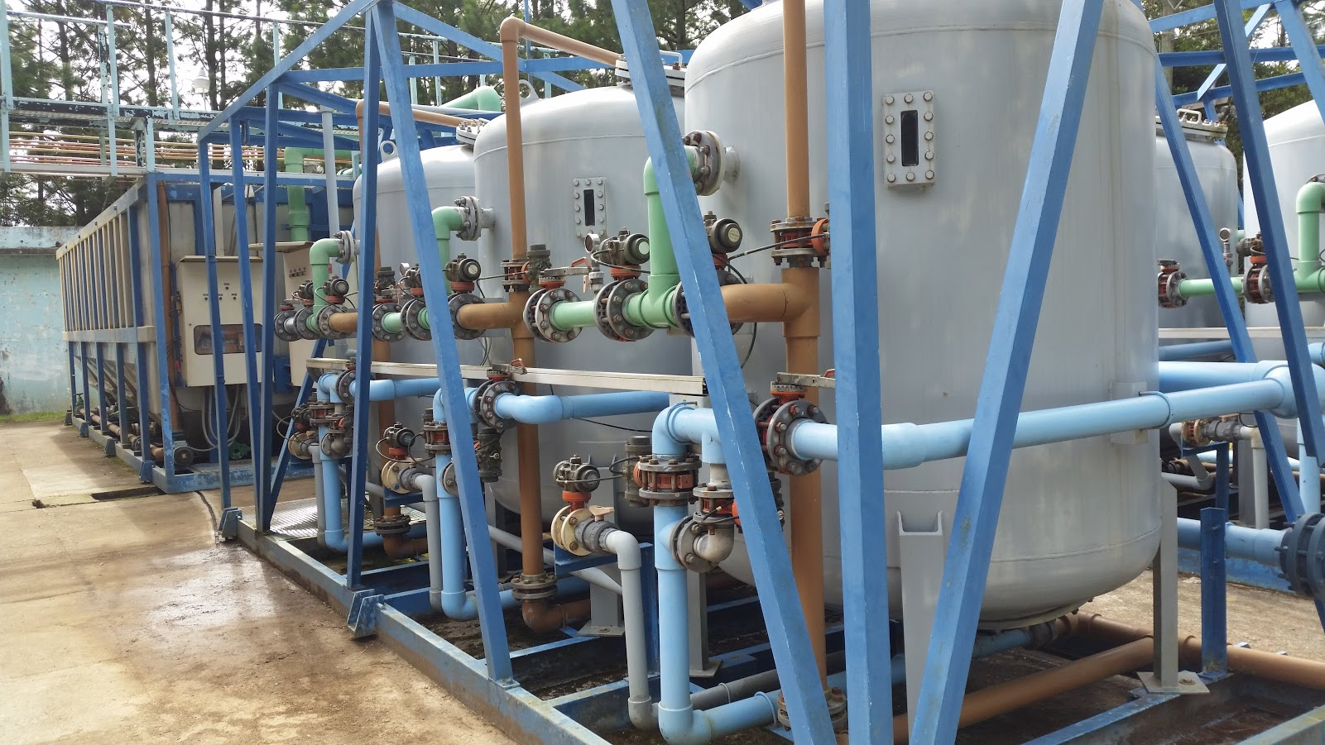
We forgot to include replacement of failing plants
Notes:
La Esperanza, Honduras

Slide 18
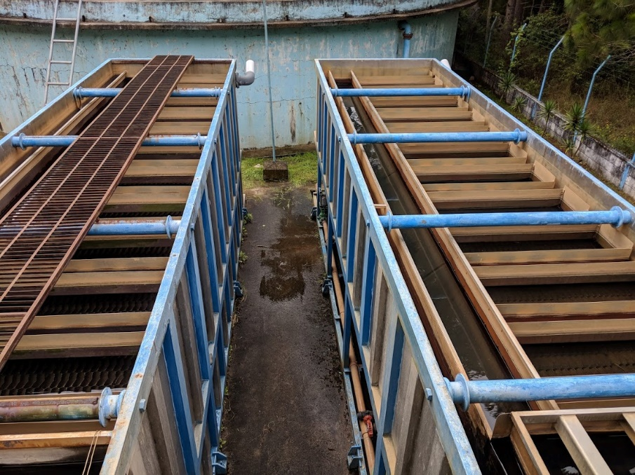
4.9 billion need new water supply systems by 2030
44 year lifetime
11 years until 2030
25% of existing plants need to be replaced
Supposedly 5.6 billion have safe water on tap
1.4 billion need upgraded systems by 2030

Slide 19
Overview
Burden of unsafe water
The Sustainable Development Goals
Safe and Improved…
Intermittent Supplies
The technology is well developed…
Cell phones vs. municipal water technology
A role for universities
Ctrl + click the pictures to go each section!

Slide 20
Intermittent Supplies
It is estimated that over one-third of the urban water supplies in Africa, and in Latin America and the Caribbean, and more than half those in Asia, operate intermittently.
Why are supplies intermittent? _______________
Crude form of rationing
Lack of meters
Leaking system – reduce amount of water lost
Some sections of the city might never receive water otherwise
Elevation challenges!
Rolling blackouts
Notes:
http://www.who.int/docstore/water_sanitation_health/Globassessment/Global3.4.htm

Slide 21
What is your experience with intermittent water supply?
I’ve always had accessed to water at the tap
I visited a city where water was intermittent
I grew up in a town or city where water was intermittent

Slide 22
You just acquired a hotel in downtown Delhi, India
Electricity is intermittent, what do you do?
Water is intermittent, what do you do?
How can you get more water?
How does each affect your water quality?

Slide 23
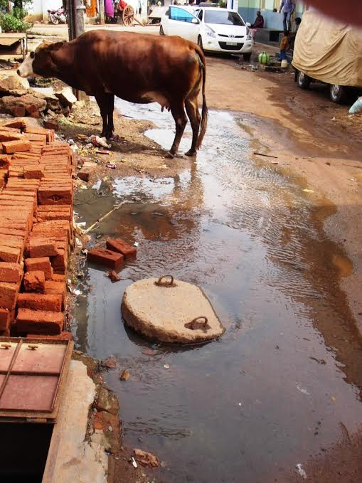
Leaks don’t cause contamination unless the flow is INTO the pipe
Necessary conditions:
Saturated contaminated soil
Leaky Pipe
Pressure outside pipe must exceed pressure inside pipe
Potential Causes:
Negative pressure transients
Booster pumps
*Photo credits
Top: http://texas-slab-leak-repair.com/water_leak
Bottom: Emily Kumple
Notes:
David Gold, Alicia Peters, Weier Chen,Lucia Garcia-Iturri Gallego, Distribution System Contamination Prevention
https://docs.google.com/presentation/d/1FbHpETKLk-6JZaqnlvxxkkQqu3iSUCvia9jvmYfr5kg/edit#slide=id.p21

Slide 24
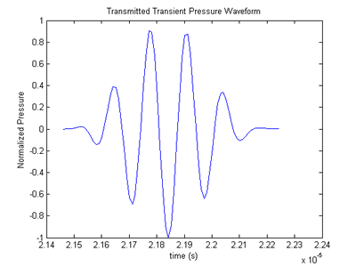
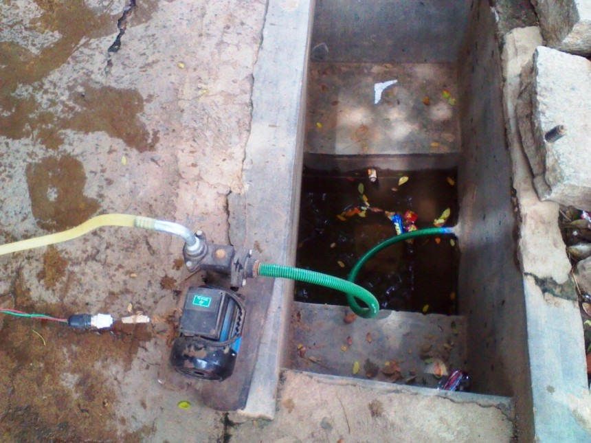
Booster pumps that pull water from the distribution system should be banned
Pressure Transients
Boster Pumps
Image credits: http://www.egr.msu.edu/~fultras-web/images/applications/gui/PressureWaveform.png
Emily Kumple
Notes:
David Gold, Alicia Peters, Weier Chen,Lucia Garcia-Iturri Gallego, Distribution System Contamination Prevention
https://docs.google.com/presentation/d/1FbHpETKLk-6JZaqnlvxxkkQqu3iSUCvia9jvmYfr5kg/edit#slide=id.p16

Slide 25
The Point of Use (POU) Treatment Preference and the spiral to failure
A Hypothesis – Given that
centralized water supply systems always have leaks
intermittency is common when water is in short supply
contaminated water can flow into the supply pipes when they aren’t pressurized
Centralized systems often fail to meet standards
Use Household level (Point of Use) and reduce funding to maintain the central water supply system – spiral to failure
Notes:
Discuss and then vote

Slide 26
Overview
Burden of unsafe water
The Sustainable Development
Goals
Safe and Improved…
Intermittent Supplies
The technology is well developed…
A role for universities
Ctrl + click the pictures to go each section!

Slide 27
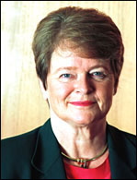
Technology isn’t the problem
Former World Health Organization Director-General: Dr Gro Harlem Brundtland speech at Cornell University in 2005
Loosely paraphrasing…
We have the technology to solve the world’s problems – what is missing is education, institutional capacity, and political will
Reflect! This was before electric cars
Notes:
This is the “engineers are irrelevant hypothesis”.

Slide 28
Policy, Education, Institutions
AND
Technologies

Slide 29
Policy, Education, Institutions or Engineering
and
You can sometimes compensate for poor engineering by providing more inputs
Energy – fossil fuels
Education
Money
Management
Labor
You can sometimes reduce this burden on society by improving the technologies
These factors are multipliers!!!!

Slide 30
These factors are multipliers!!!!
Energy x Education x Money x Governance x Labor x Technology = ?
1x1x1x1x1x0=0
1x1x½x1x1x2=1
Notes:
You can sometimes compensate for poor engineering by providing more inputs
Energy – fossil fuels
Education
Money
Management
Labor
You can sometimes reduce this burden on society by improving the technologies
These factors are multipliers!!!!

Slide 31
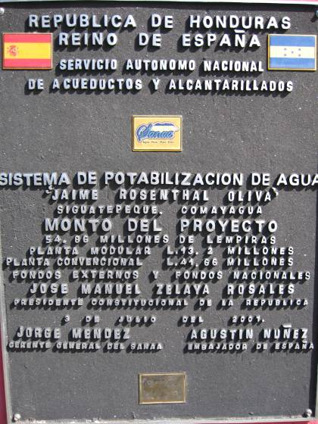
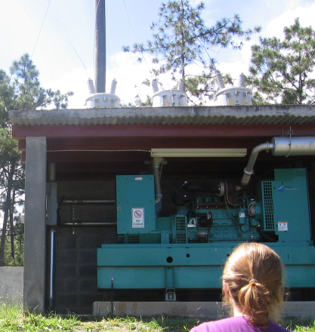
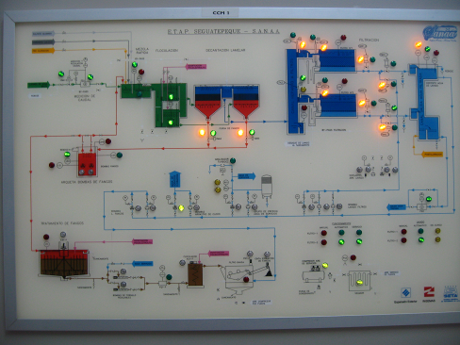
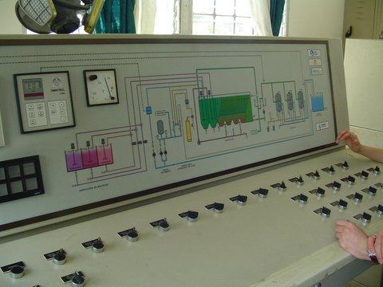
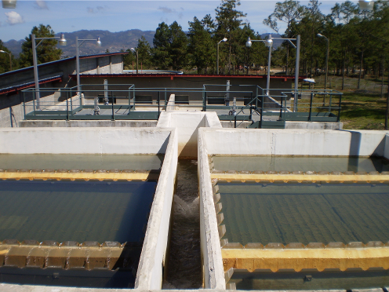
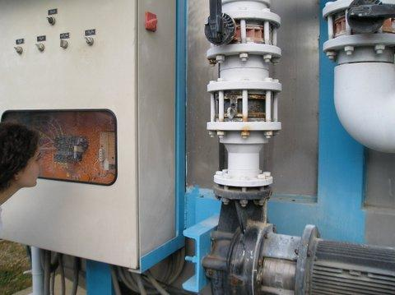
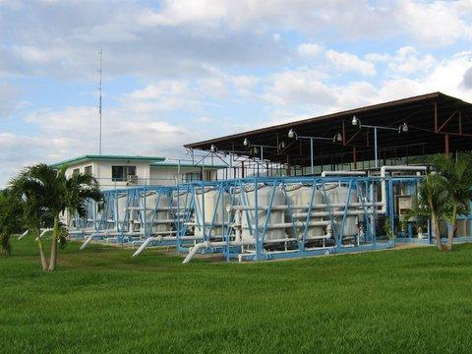
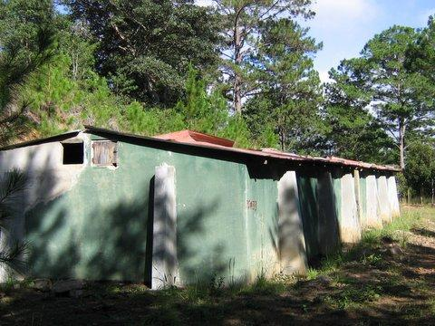
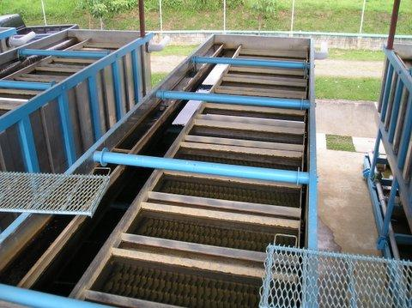
“advanced” and “appropriate” and “AguaClara” technologies can fail
El Progreso,
Modular BEKOX
Vulnerable
Siguatepeque
Civil Work
Vulnerable
Marcala, Honduras
No chemicals
Upflow filtration
Abandoned (Replaced with AguaClara)
4 veces mas cara que AguaClara
Notes:
Ethics of Engineering Experimentation

Slide 32
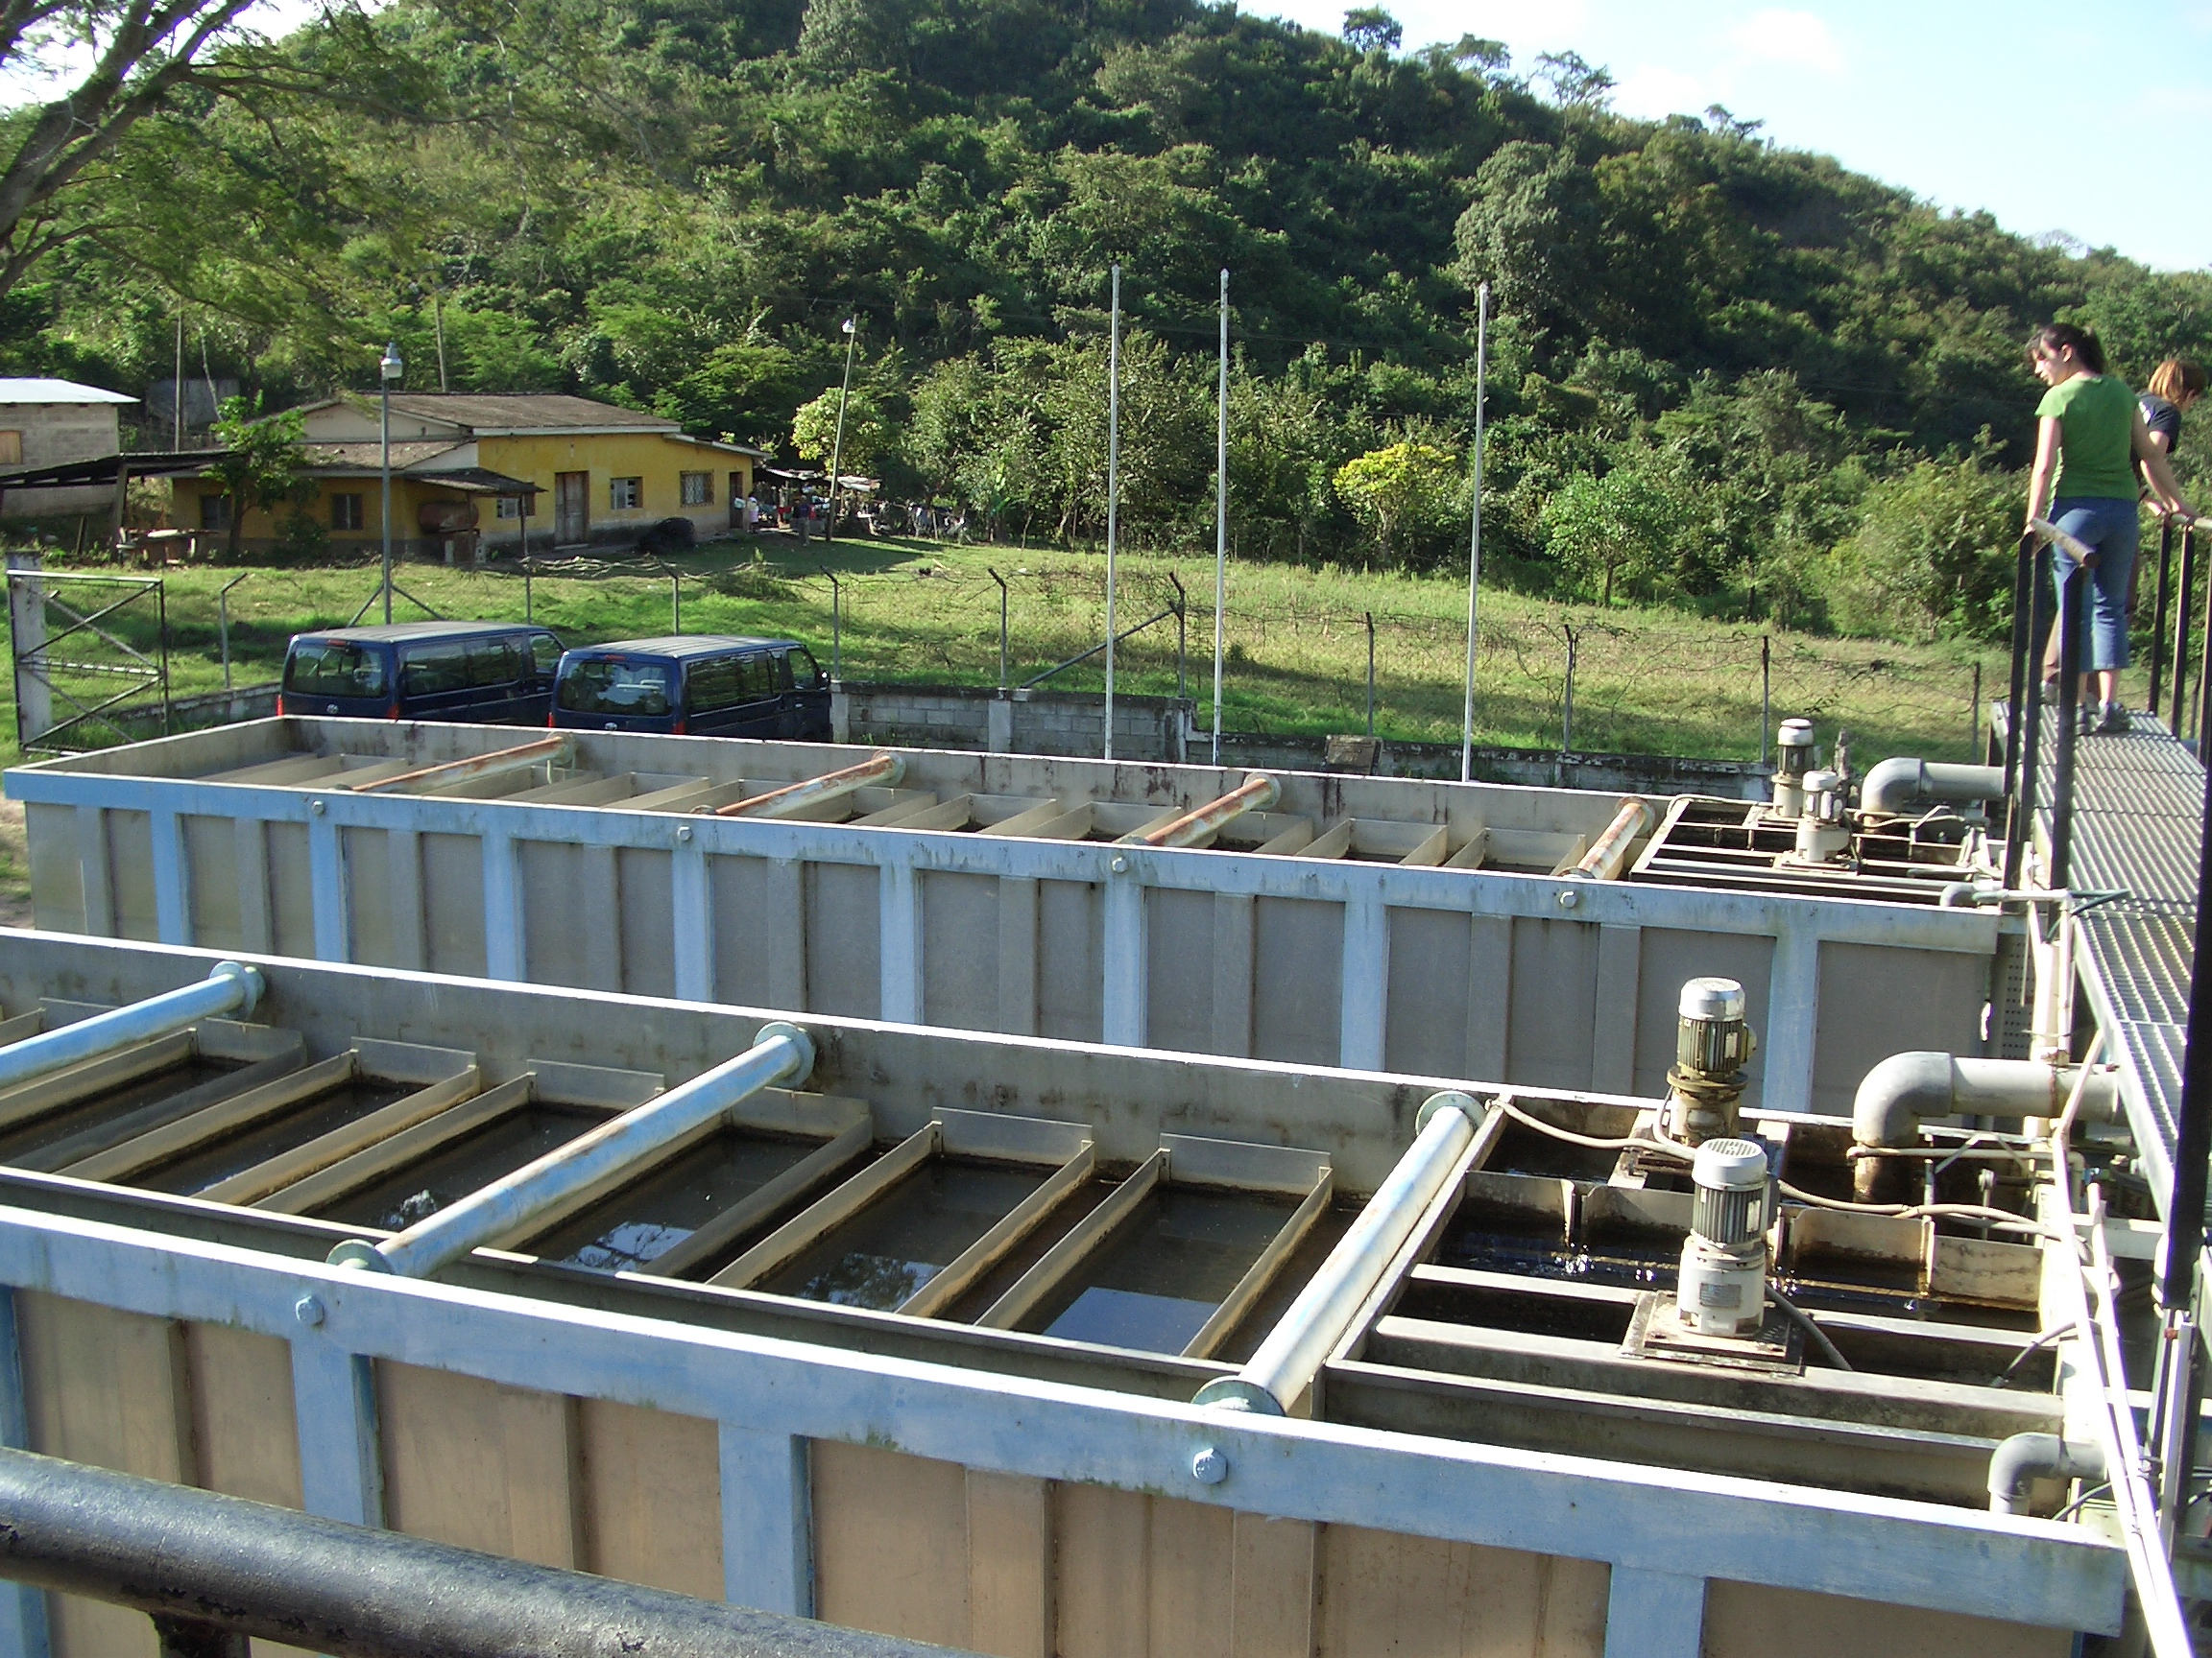
Package Plants

Slide 33
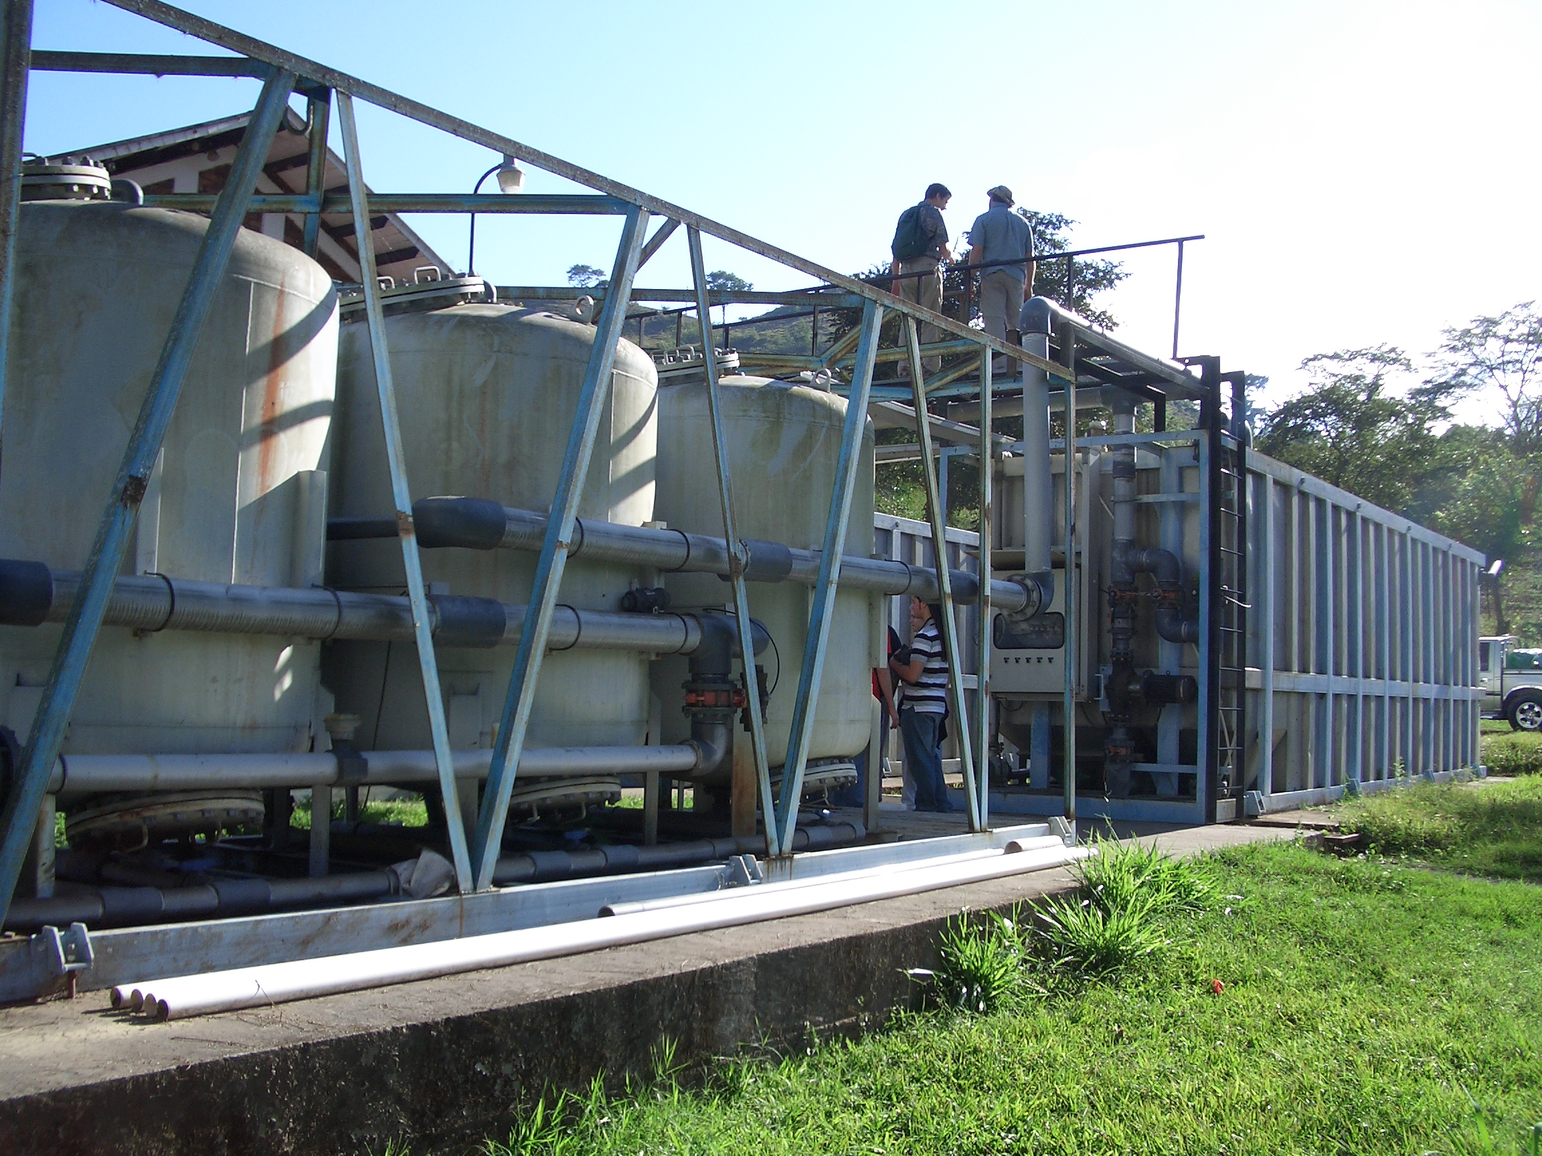
Dominant Design Constraint?
Notes:
What was the constraint used to create this design???? Constraints matter! The design you create will strongly reflect the constraints that you used to guide the design.

Slide 34
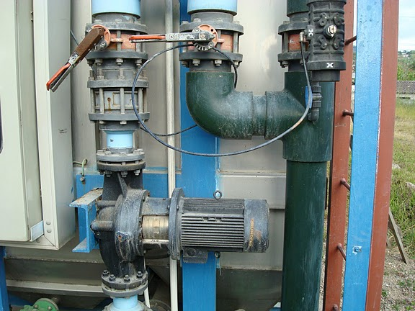
Failure to design for energy efficiency

Slide 35

Failure to design for the Operator

Slide 36
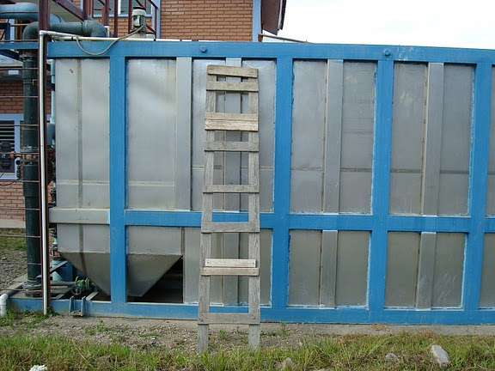
Failure to design for the Operator

Slide 37
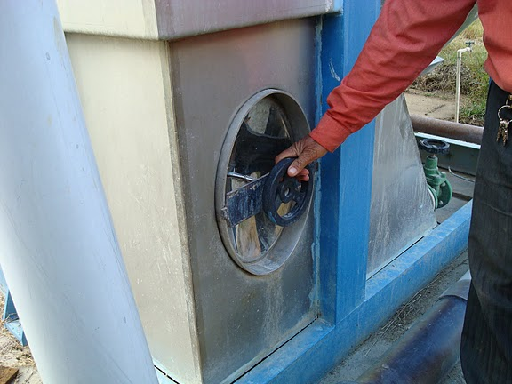
Failure to design for the Operator

Slide 38
Overview
Burden of unsafe water
The Sustainable Development Goals
Safe and Improved…
Intermittent Supplies
The technology is well developed…
Cell phones vs. municipal water technology
A role for universities
Ctrl + click the pictures to go each section!

Slide 39
A Role for Universities
Develop new knowledge
Test the designs in pilot scale field trials
Make that knowledge available to the global community
Open source engineering!
Capacity building: training the trainers
Bring the power of automation to engineering design (Take Henry Ford’s idea out of the realm of widgets and into the realm of knowledge)

Slide 40
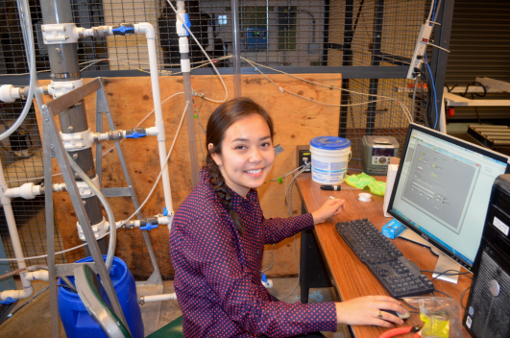
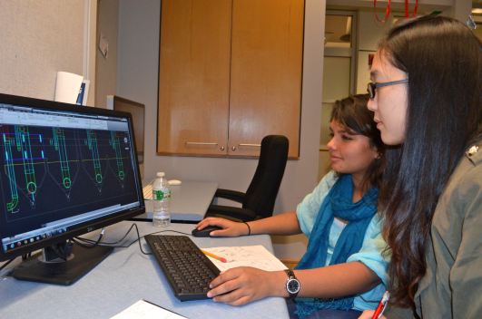
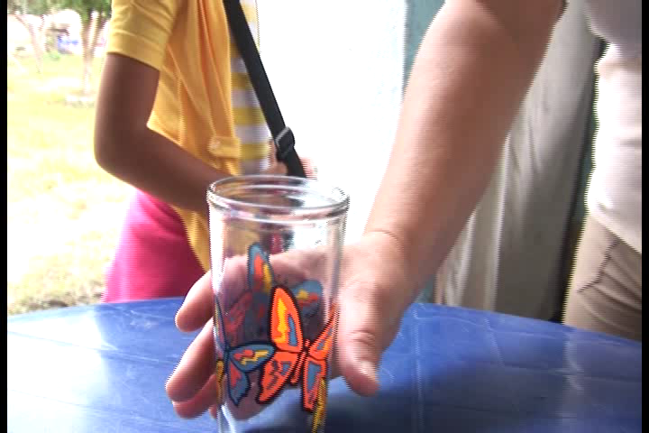
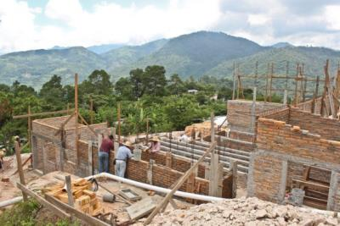
Open-Source University-based Research and Development
New Theories
Research Laboratory
Design Studio
Journey Inward
Journey Outward
Safe water on tap
Sustainable Infrastructure
Notes:
From the research lab to new understanding of the physics to the design studio to the construction site to the tap
"research invent design empower"

Slide 41
Low Carbon Footprint Technologies
Previous generations of engineers designed infrastructure that required cheap fossil fuel
It is long past time for a new paradigm
The original motivation for developing energy efficient technologies was the majority world, but many of these technologies will be the preferred option for wealthier communities too
Everyone likes cheaper, better, and more reliable

Slide 42
Hypotheses: The Grand Experiment
Technology should be designed based on the conditions under which it will operate
For infrastructure it is more efficient to disseminate knowledge than hardware
We can achieve higher coverage using a model of technology dissemination in which we share knowledge openly

Slide 43
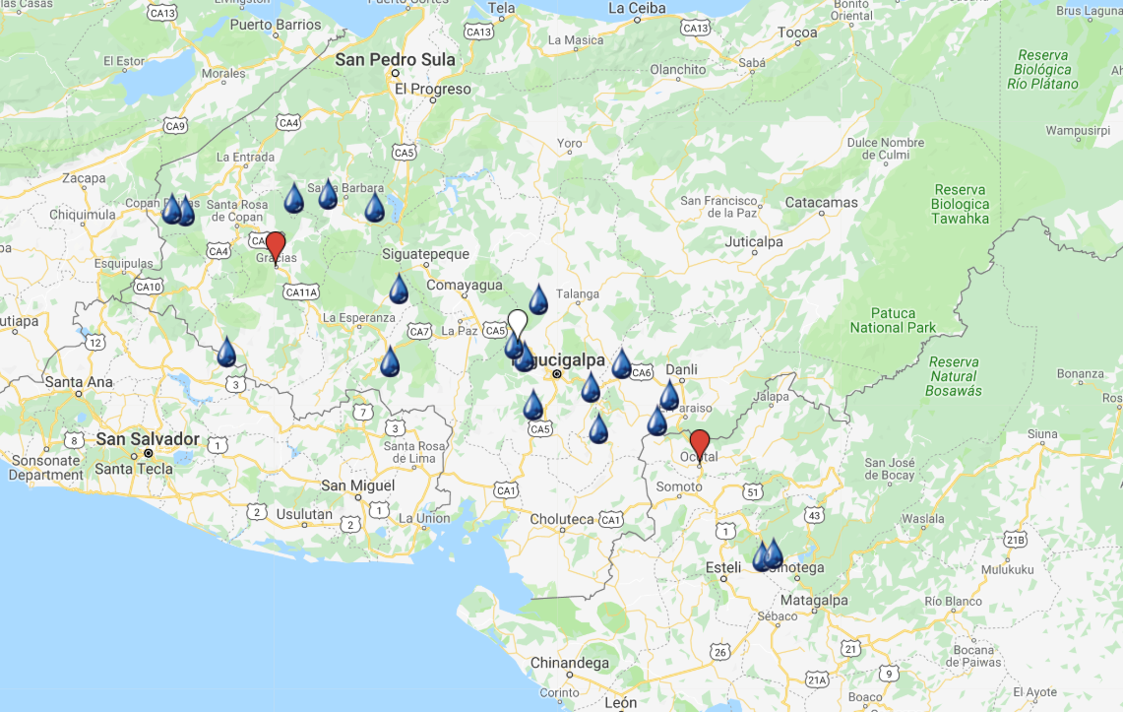
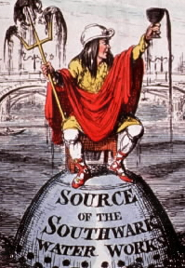
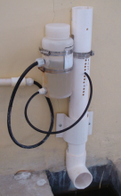
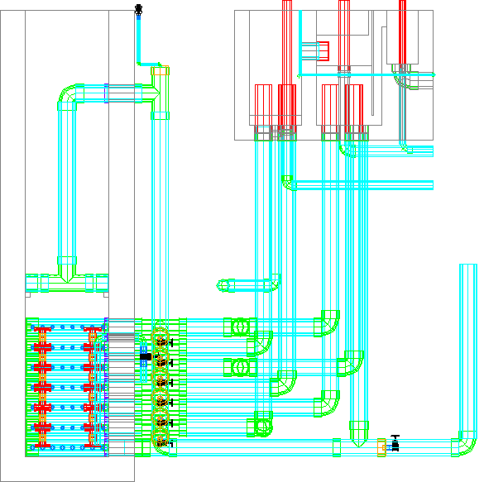
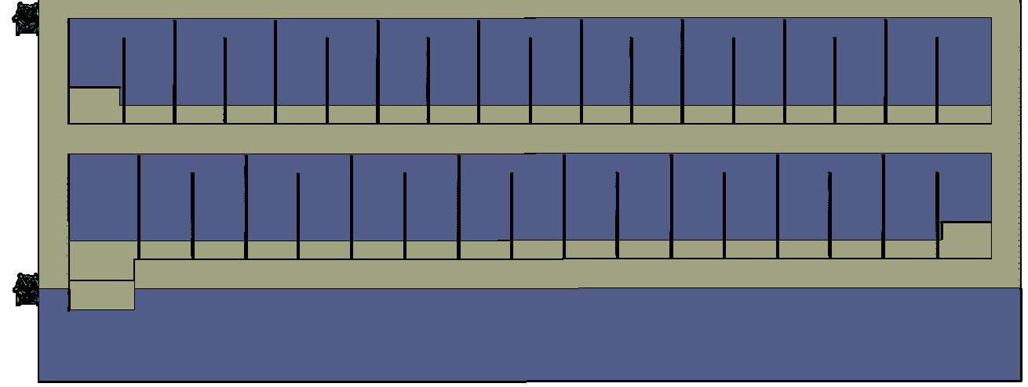

Where are we going?
The Challenge!
Control and measure flow
Flocculation
Sedimentation
Filtration
Disinfection

Slide 44
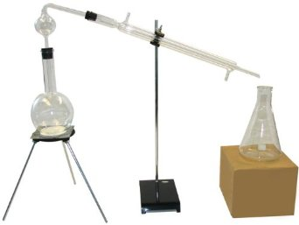
Suppose distillation were the only method that environmental engineers had developed to create clean water
All water in pipes delivered to homes was unsafe
What would you say is the limiting factor preventing implementation of safe piped water?
Weak institutions
Corruption
Weak Economies
Poor education
Inadequate technology
What do you conclude?
Notes:
We have the technology. The problem is weak economies.

Slide 45
Why aren’t there better technology choices?
We have a solution that works for strong economies (conventional water treatment)
Individual cities can’t afford to hire consulting firms to conduct research to develop better technologies
Each city chooses conservative existing designs
The same is true for countries in the Majority World (they can’t afford the R&D to develop better technologies)

Slide 46
Continual optimization? Cell Phones vs. Water Treatment
Why are cell phones continually getting cheaper and better?
Why is conventional water treatment not enjoying a similar optimization?

Slide 47
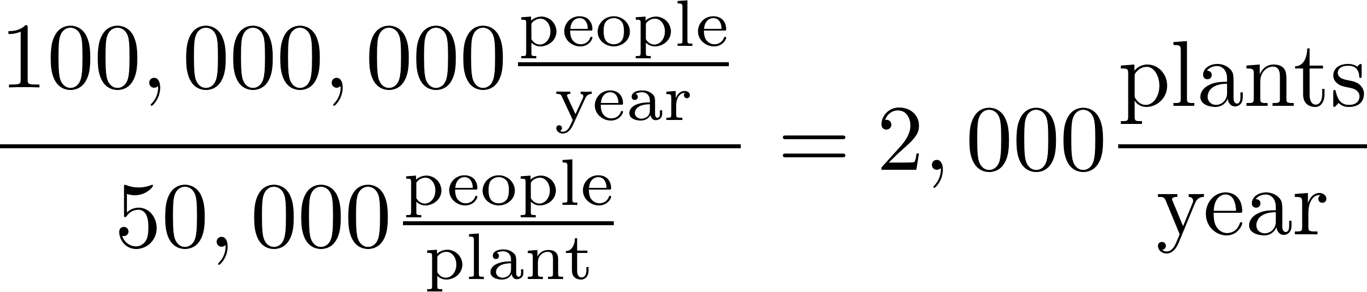
Cell Phones vs. Municipal Water Treatment
Global! | Cell phones | Municipal Water
Units per year | 850,000,000
Companies | 10? | 100s?
Incentive | Improve technology & increase market share | Successful operation at handover of each customized plant
http://www.industry.siemens.com/Water/en/markets/p_02.htm

Slide 48
Why has the Private Sector Failed to Optimize Municipal Water Treatment?
Research and development is expensive
Low volume of units and customized designs for each site
Long life of units (at least ideally!)
Vendors want to sell hardware
Consultants want to minimize liability for design
Consultants use vendors to create their designs
Can’t risk failure on a unit – conservative design prevails
Ineffective feedback mechanism
Notes:
R&D is expensive

